Slide 1


Mecatredz Technology Pvt Ltd Lucknow
AN ISO 9001:2015 CERTIFIED COMPANY

Slide 2
ABOUT
COMPANY
01
Mecatredz Technology is an IT company registered by the Ministry of Corporate Affairs (MCA).Along with software delivery we also provide software training.Every year 1000+ trainees enter the software industry by Mecatredz .Our company has been invited for the diploma and B.Tech internship by AICTE Dehli himself.Our company has also done good work.We provide diplomas and some B.Tech Colleges in free of cost workshops all over the U.P. Our company is an ISO 9001:2015 Certified for good productivity ..

Slide 3


AN ISO 9001:2015 CERTIFIED COMPANY
Mecatredz Technology is an IT company registered by the Ministry of Corporate Affairs (MCA).Along with software delivery we also provide software training. Every year 1000+ trainees enter the software industry by Mecatredz .Our company has been invited for the diploma and B . Tech internship by AICTE Delhi himself .Our company has also done good work . We provide diplomas and some B.Tech Colleges in free of cost workshops all over the U.P. Our company is an ISO 9001:2015 Certified for good productivity .
ISO 9001 2015 is internationally recognized standard which deals with Quality.
It develops a criteria to boost & polish quality and efficiency of a company or an organization.
ISO 9001 2015 makes way for an organization to solely & regularly meet the requirements of customers or clients and other involved parties.
The Quality Management System is achieved by planning and managing resources, processes and assets that combines with the final goal of customer satisfaction and organizational competence.

Slide 4
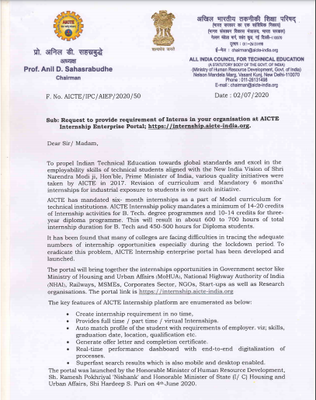
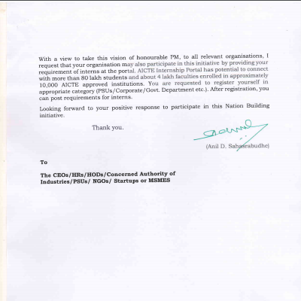
AICTE Registered Company

Slide 5
Our Services
Software Development
Placement Activities
Training Wings
Multiple Technical students having required of Projects on latest technologies . so Our Company also provide best Software Training in Lucknow . We provide all B. tech ,BCA,MCA, BSC(CS/IT),Diploma(CS/IT), PGDCA. Etc.
Our Company also organized placement drive activities into many colleges and universities .Many Students of Mecatredz Technology working into MNC Companies like as TCS ,Wipro ,HCL ,Youtube,IBM ..etc
We also working as Software development as well as Software Training . Our Company completed multiple Government and Non-Government Projects
.

Slide 6

Mobile Application Development
Some Mobile APP
Paint your app to life in milliseconds with Tasteful Hot Reload. Use a rich set of fully-customizable widgets to build native interfaces in minutes..
MY MT App
All Technology Notes App
Digital Study Notes App
Dark Study App
Tech Study Hub App
Programming Language pdf
Question Controller App
Quickly ship features with a focus on native end-user experiences. Layered architecture allows for full customization, which results in incredibly fast rendering and expressive and flexible designs.
Flutter’s widgets incorporate all critical platform differences such as scrolling, navigation, icons and fonts, and your Flutter code is compiled to native ARM machine code using Dart's native compilers.

Slide 7
Our Web Applications
www.mmitaligarh.org.in
www.employeebtup.com
Mahamaya IT Polytechnic Aligarh
01
04
Board Of Technical Education Utter Pradesh
www.hdps.org
www.pvmsvdic.com
HDPS Mathura.
02
05
Prakash Vidhya Mandir Inter College Sitapur
www.questioncontrolletr.com
03
www.shopperskeyindia.com
06
LPU Jalandhar Punjab
Shoppers Key Pvt Ltd (MLM)

Slide 8
Type of Our Training Program
1. Apprenticeship Training
Apprenticeship Program is totally job oriented training program of Mecatredz Technology. You can do 100% job by doing this training .its duration is 150 days to 180 days. Those who want to get jobs soon, people can join this training program. In this training program, we tell you about technology as well as office environment so that you can work in the technology sector. This training can be done by all the trainees who are in the final year or pass out . In this training program we offer double technology.
2. Summer/Vocational Training
This Training Program is special for B.Tech/BCA/MCA/B.Sc(CS/IT) students .Summer Training program incorporates project training along with a focus on covering the fundamentals of the respective technologies.MECATREDZ TECHNOLOGY aggressively escalates it by providing job-oriented summer training for 1st year/2nd year/3rd year/ 4th CS/IT engineering students with a huge network of industry-certified trainers, who specialize in the domains like .NET, Java, Python, Oracle, PHP, Cloud Computing, Mobile App development etc., necessary for providing effective training.
3. Winter Training
Winter Training is only for learning purpose training program that is launched by Mecatredz Technology Pvt. Ltd Lucknow .Every student can enhance your knowledge skills .we offered only single technology to every student .Every student of B.Tech (CS/IT),BCA ,B.Sc(CS/IT) or diploma can join this training program .
4. Industrial Training
Industrial Program is also a unique program of Mecatredz Technology .its duration is 100 days to 120 days . Those who want to get jobs soon, people can join this training program. In this training program, we tell you about technology as well as office environment so that you can work in the technology sector. This training can be done by all the trainees who are in the final year or the final semester. By doing this training, you can work till the final year.

Slide 9
5. Project Training
We do the project training according to the student's requirement. If someone wants to build their project, then you can choose a particular technology and you can complete the project by joining with Mecatradez Technology.
6. Home Training
The colleges which are around Lucknow and the students of that college want to study technical subjects. If want to learn as a practical knowledge then you can join into this training .it is also a unique training program .
7. Online Training
In the year 2020, our company provided free online training to around 1500 students. Because the whole world was troubled by an epidemic like Corona and the economic situation of all of us was spoiled. If you want to train online on any technology from here, then you can join.
8. Software Training
A training software (also known as a Learning Management System) is a software application that facilitates online training. ... It gives you the ability to create courses, organize employees into groups, assign training to users, and run tests and assessments.

Slide 10
Every Training Scenario
START
Programming
UI Technologies
Databases
Technologies
Firstly We Provide Programming Language Like as C & C++, Java, Python…..etc
Mtechnology Start Basic UI Technologies Concept Like as HTML5, CSS3,Bootstrap 3,4, Javascript, jquery, Ajax,…etc
And Some Advance Topic ReactJS, NodeJS, AngularJS,Rect Full API….etc
Mecatredz Working All database Like- Oracal, SQLLite,MYSQL,SQL Server…etc.
We Provide technologies with Frameworks like as
1.Asp.Net MVC
2.Java with Spring
3.Java with JSP
4.Java with Servelt
5.Android
6.PHP With Laravel
7. Python With Django
8.Python With ML.
.

Slide 11
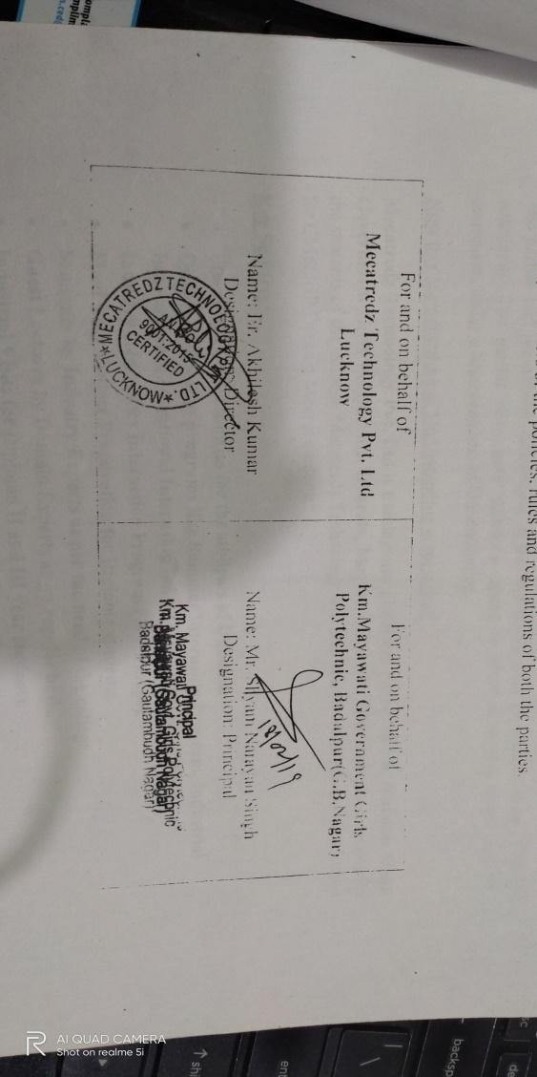
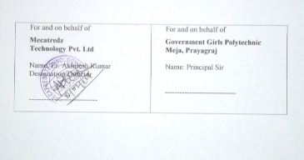
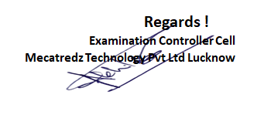
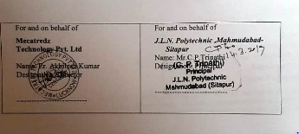
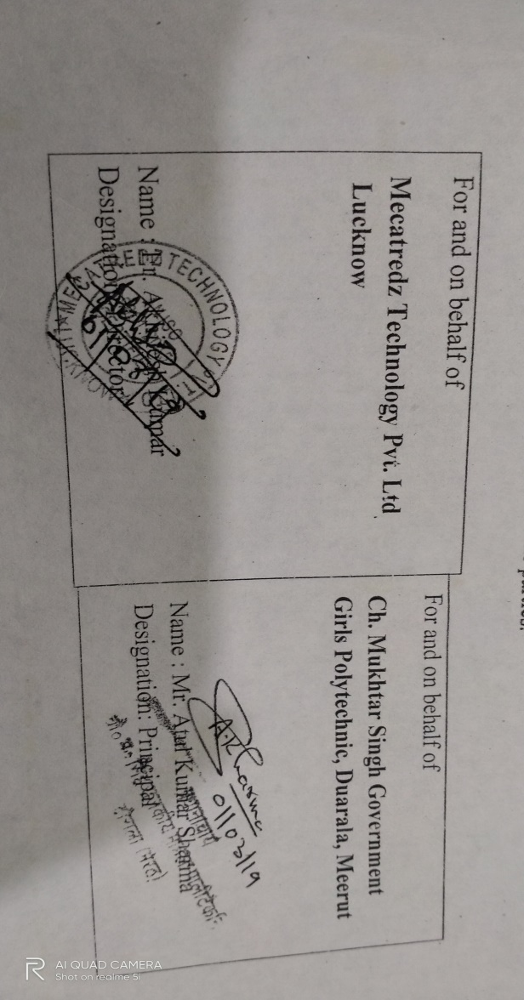
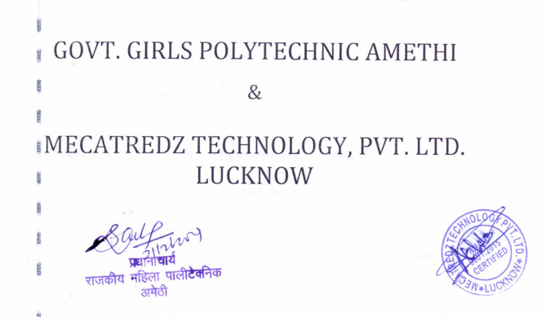
Some MOU Screenshots
Govt Girls Polytechnic MEZA
KM. Govt Girls Polytechnic Badalpur
JLNP Mahmudabad
Gov’t Girls Polytechnic Amethi
CMS Polytechnic Meerut

Slide 12
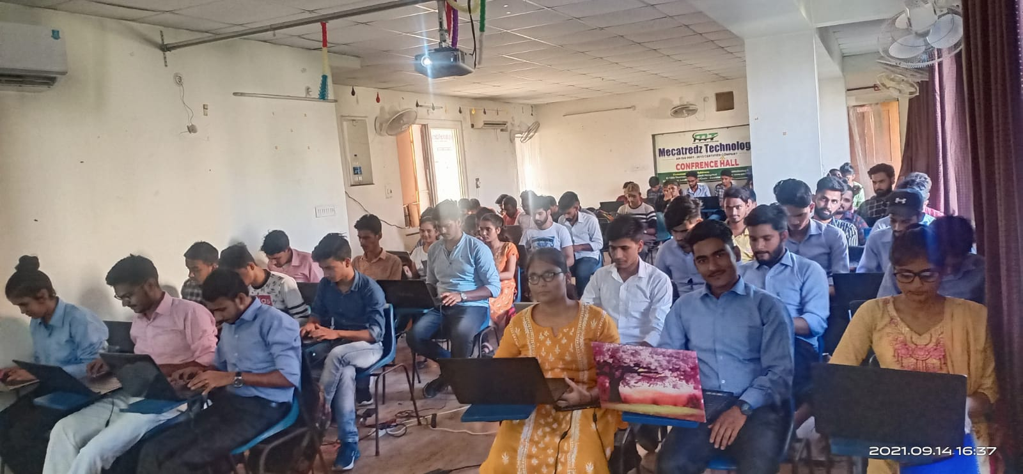
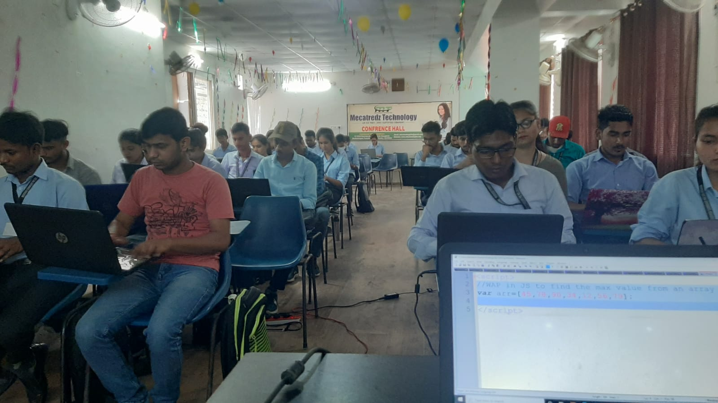
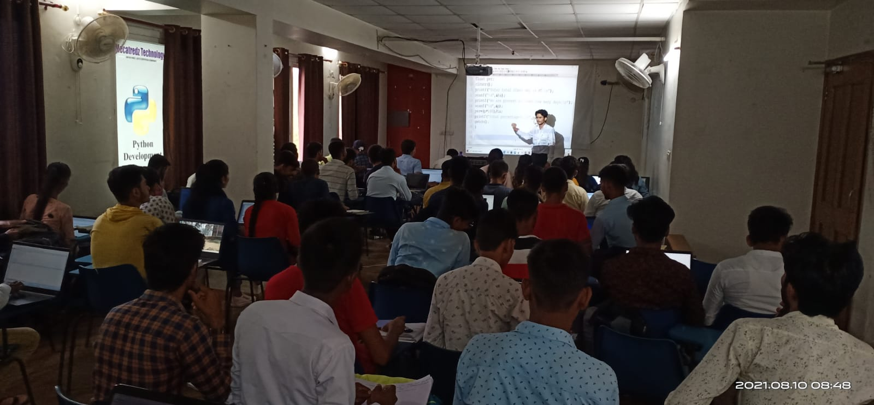
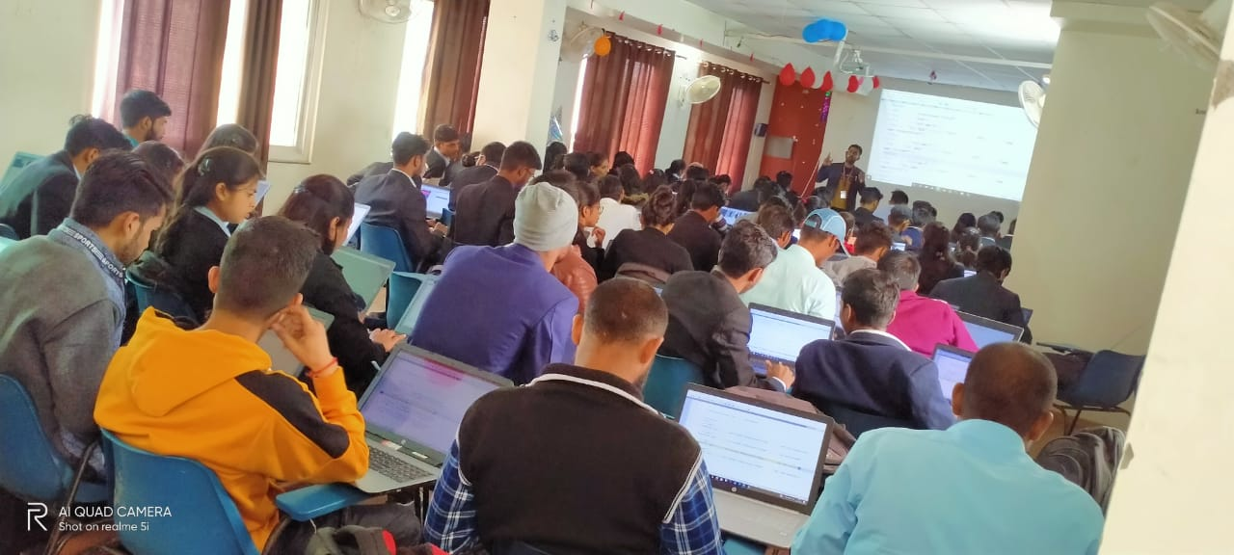
Current Apprenticeship Training Crowd 2021-22

Slide 13
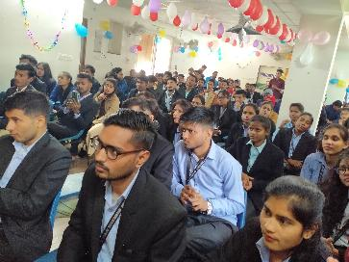
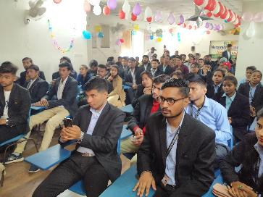
Apprenticeship Training Crowd 2020-21

Slide 14
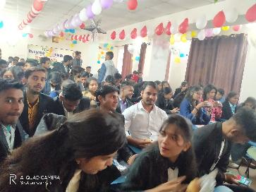
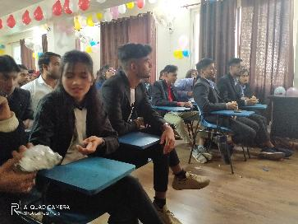
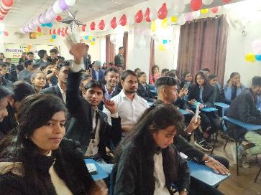

Slide 15
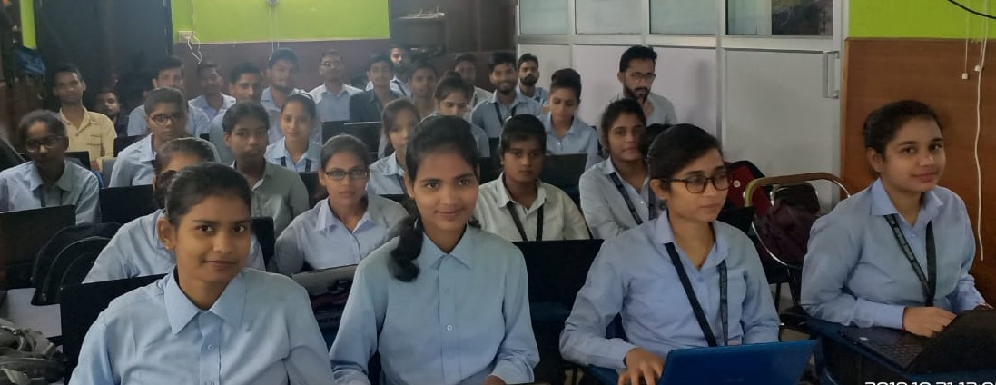
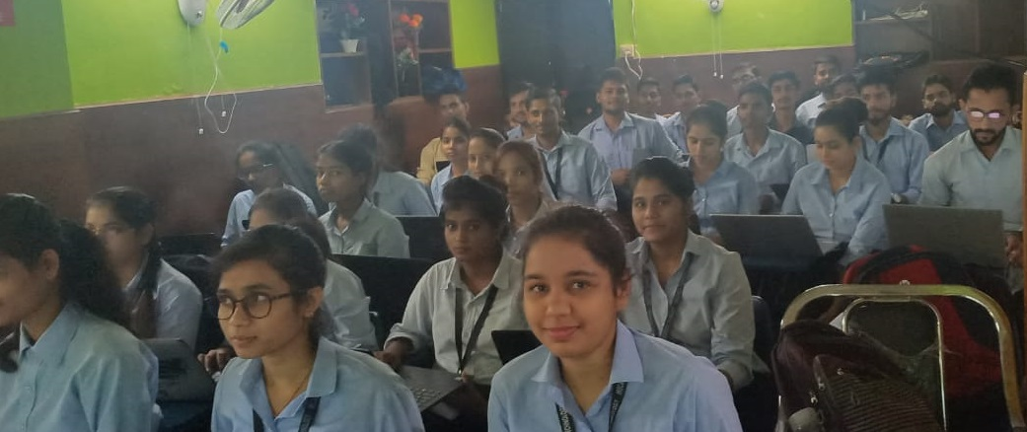
Our Apprenticeship Training Crowd 2019

Slide 16
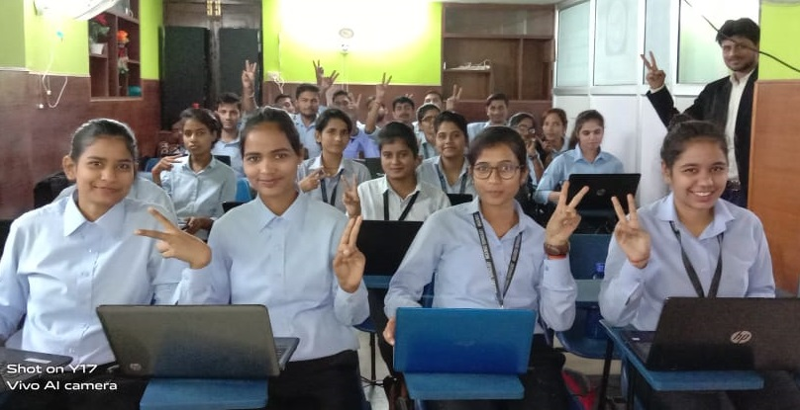
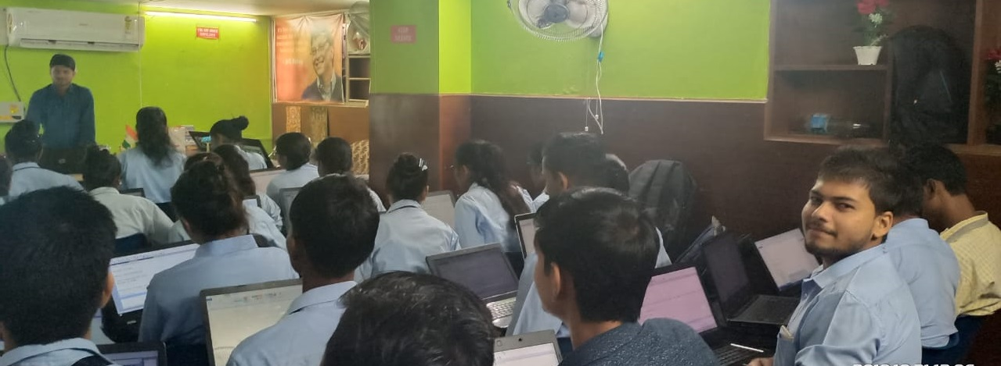

Slide 17
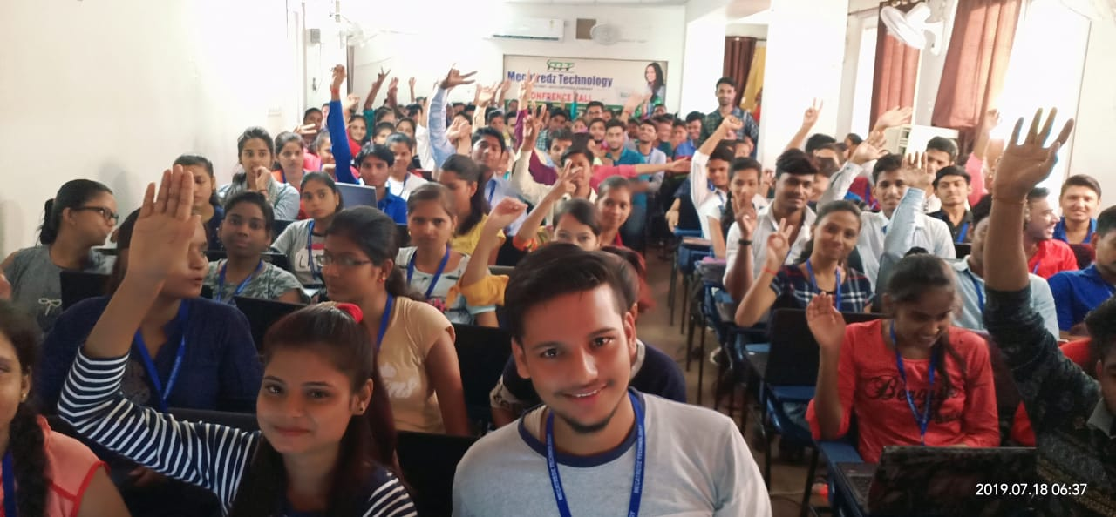
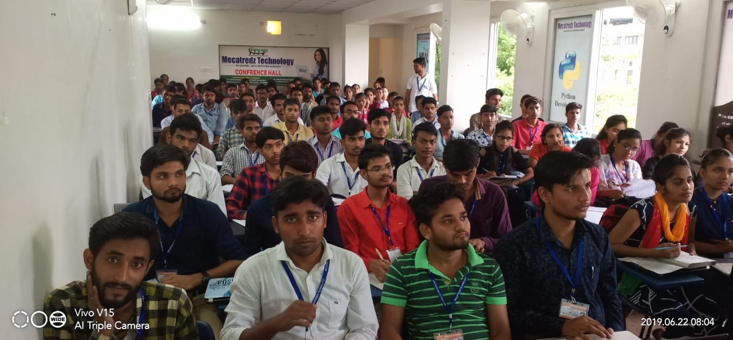
Our Summer Training Crowd

Slide 18
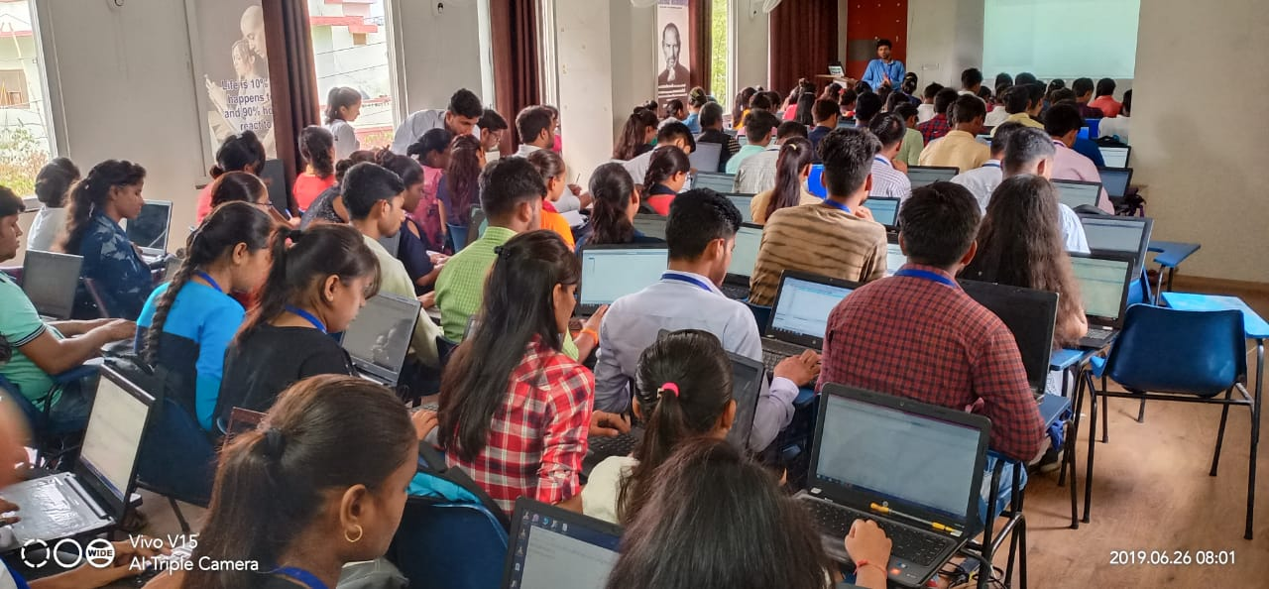
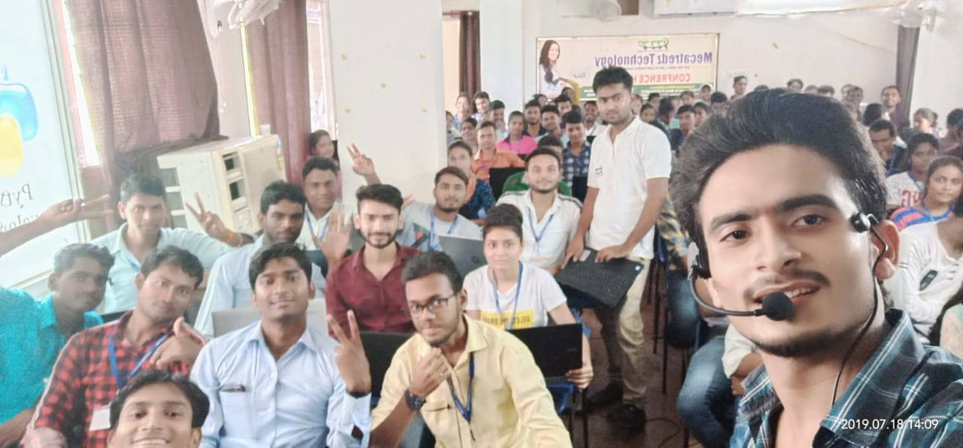

Slide 19
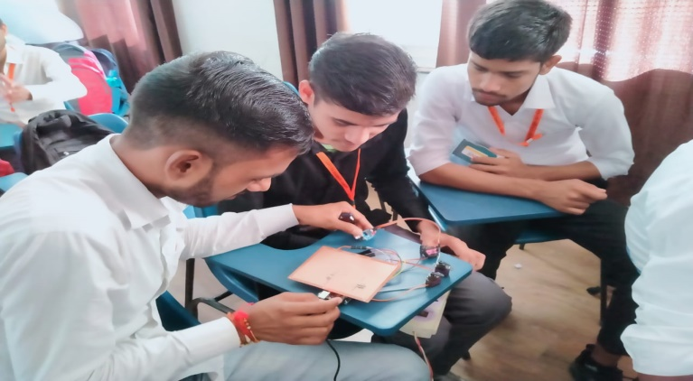
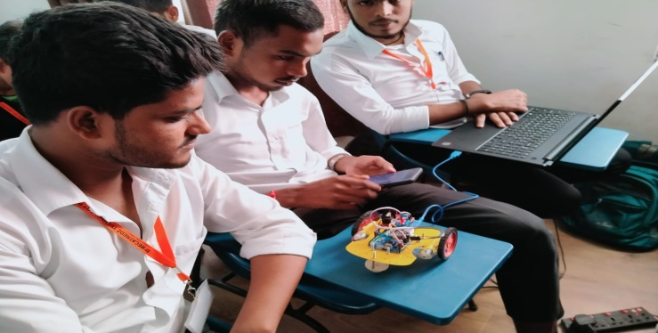
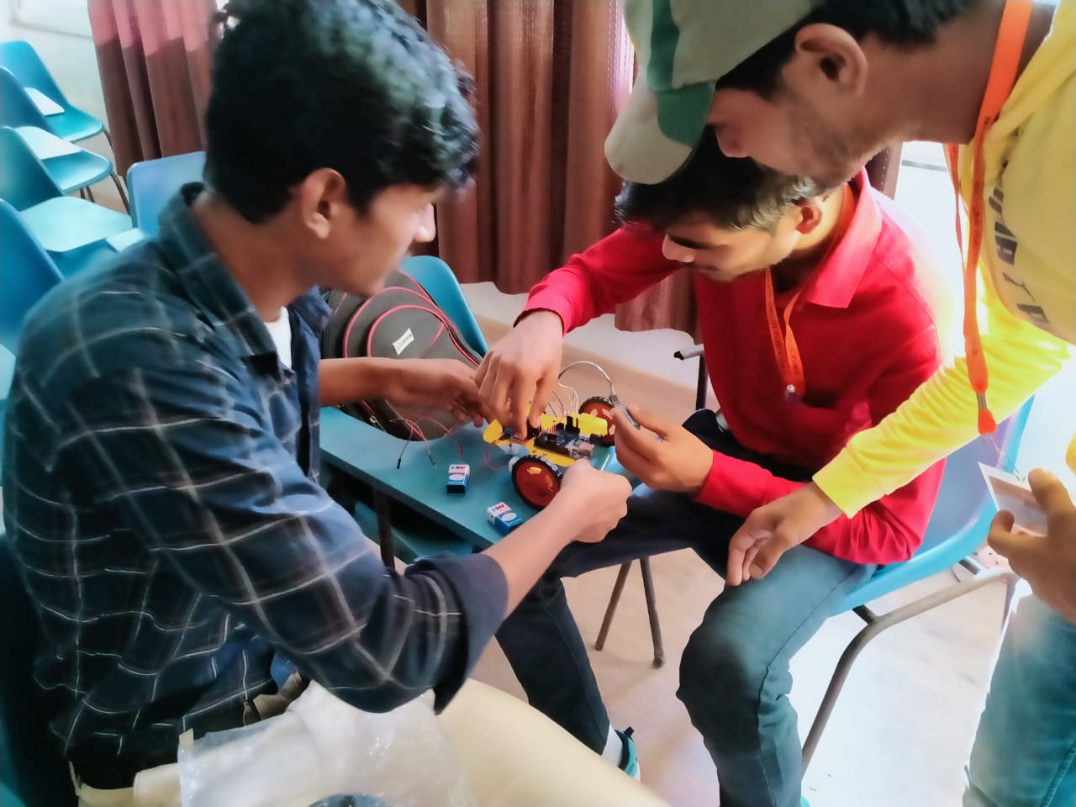
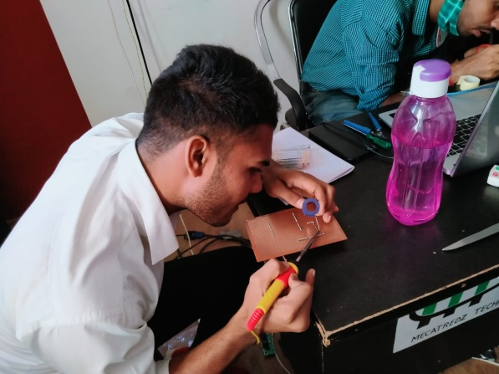
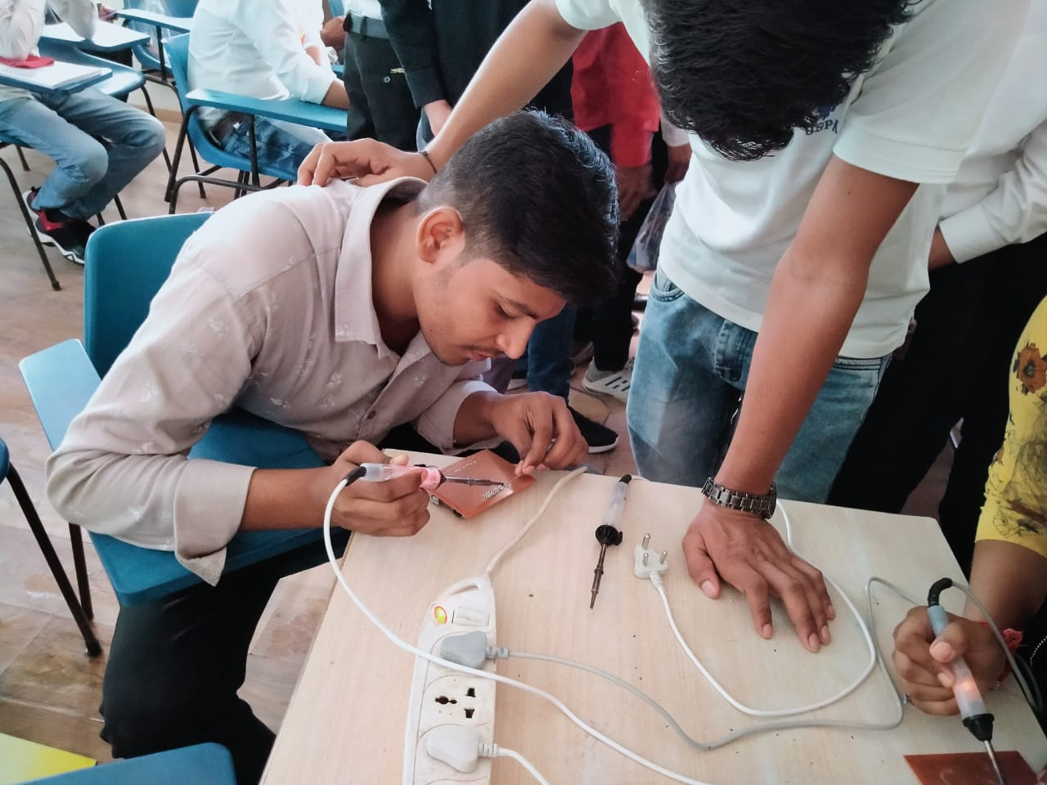
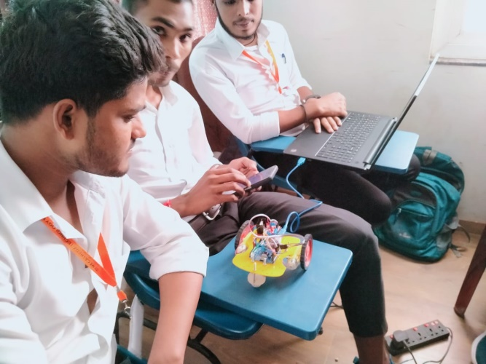
Summer Training EC/EE Batch

Slide 20
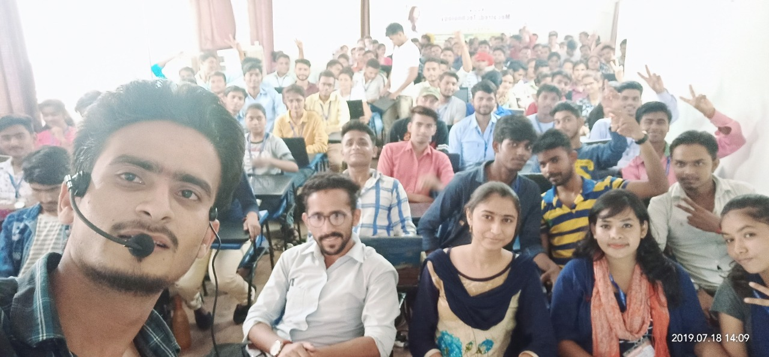
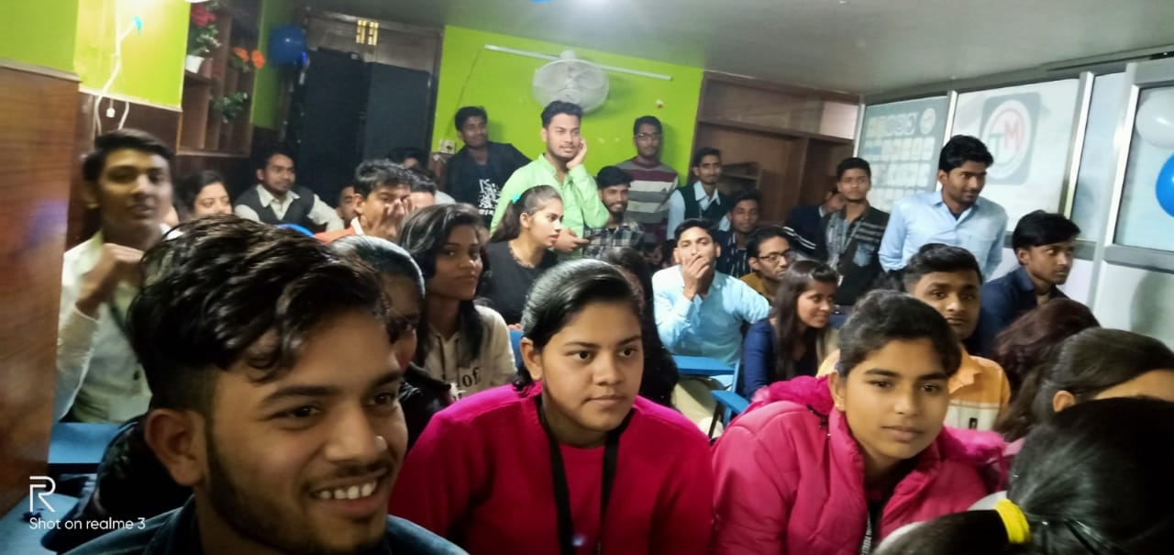
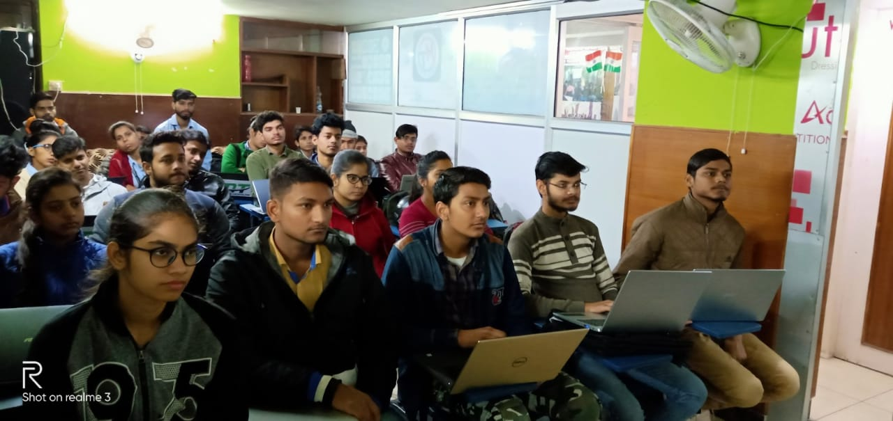
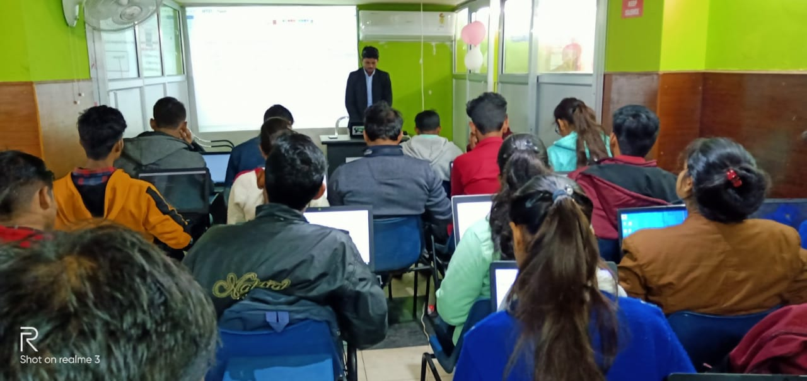
Our Winter Training Crowd

Slide 21

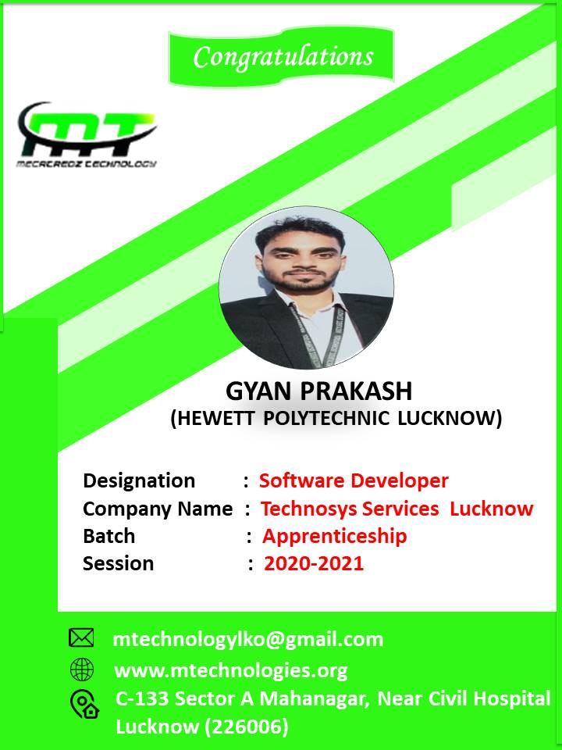
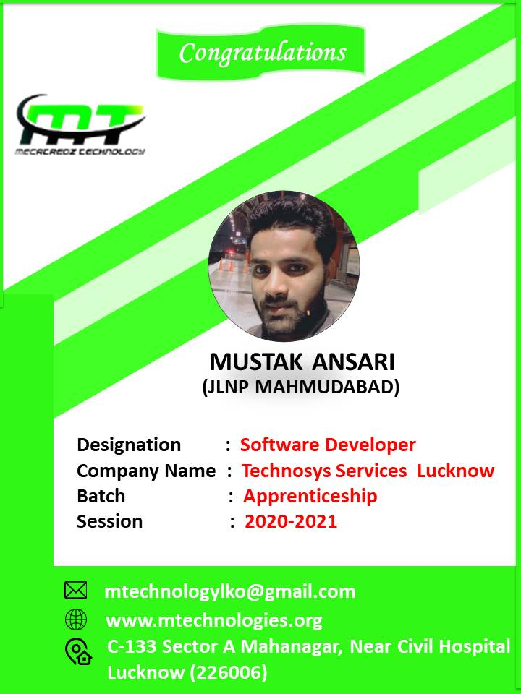
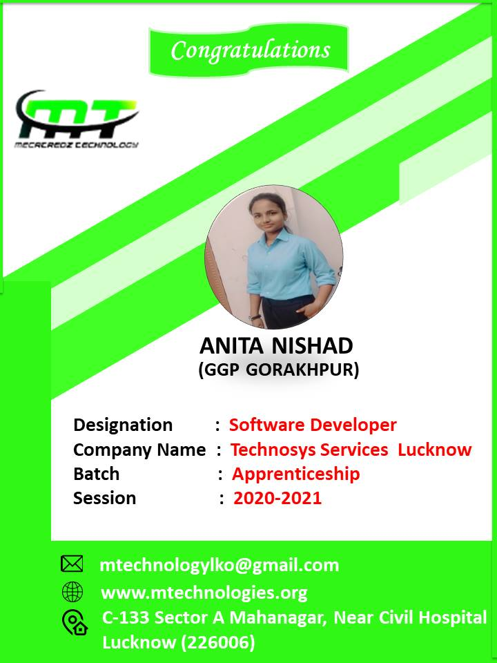
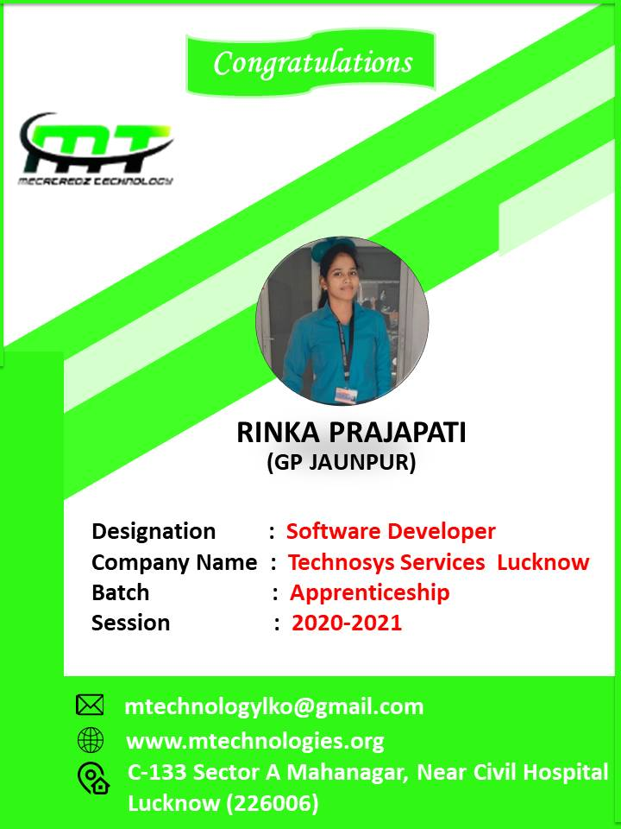
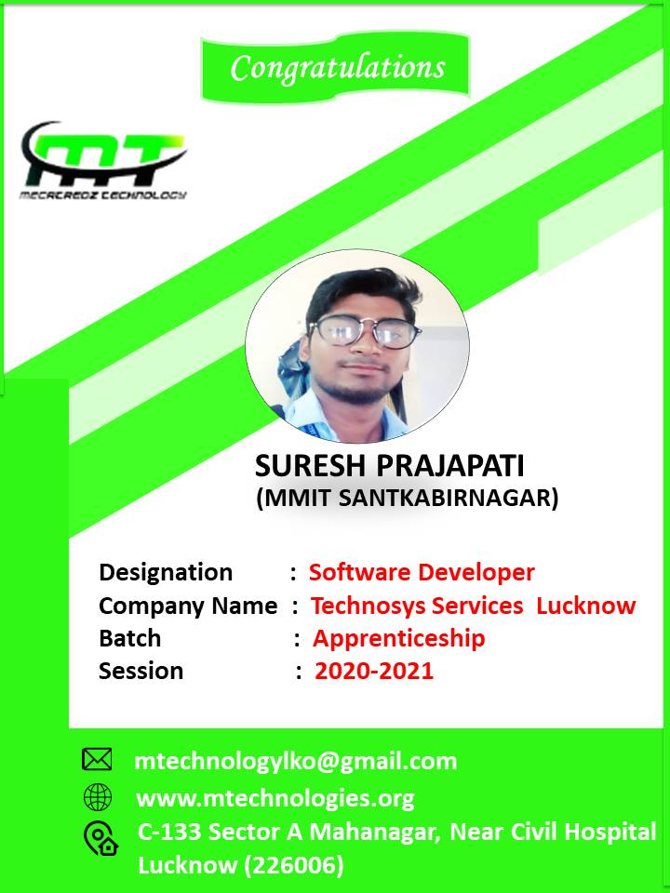
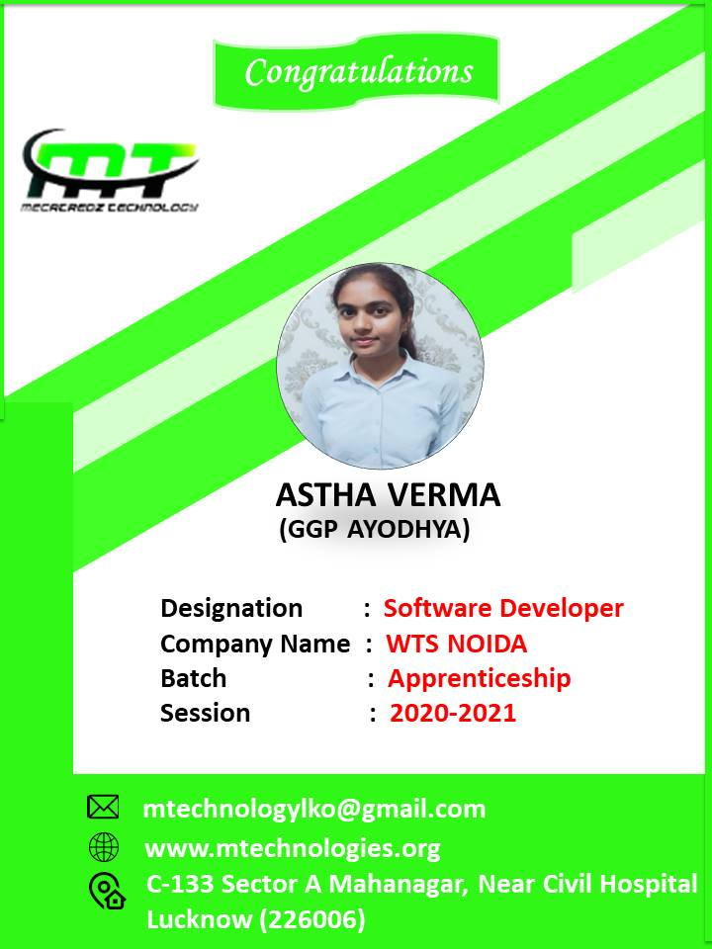
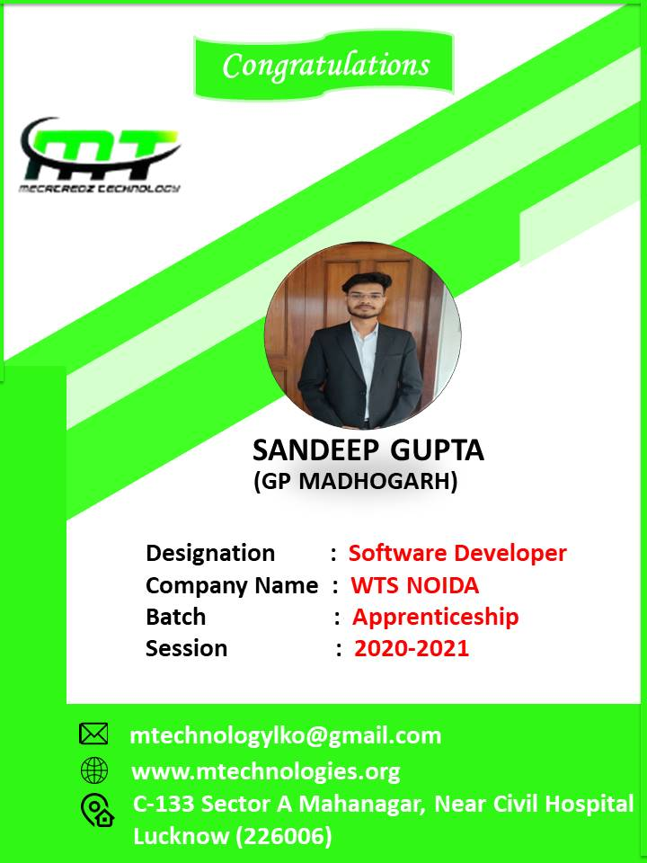
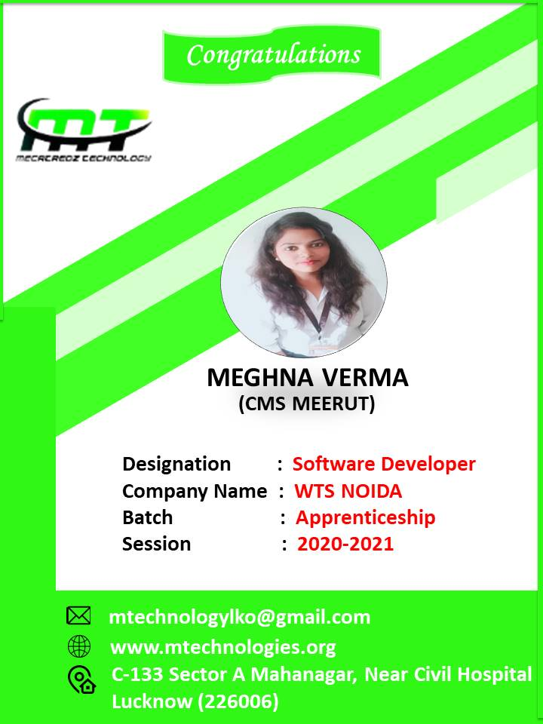
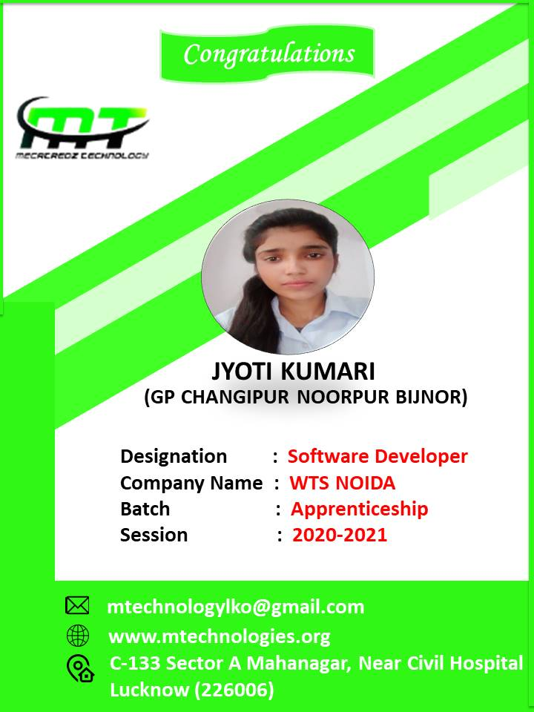
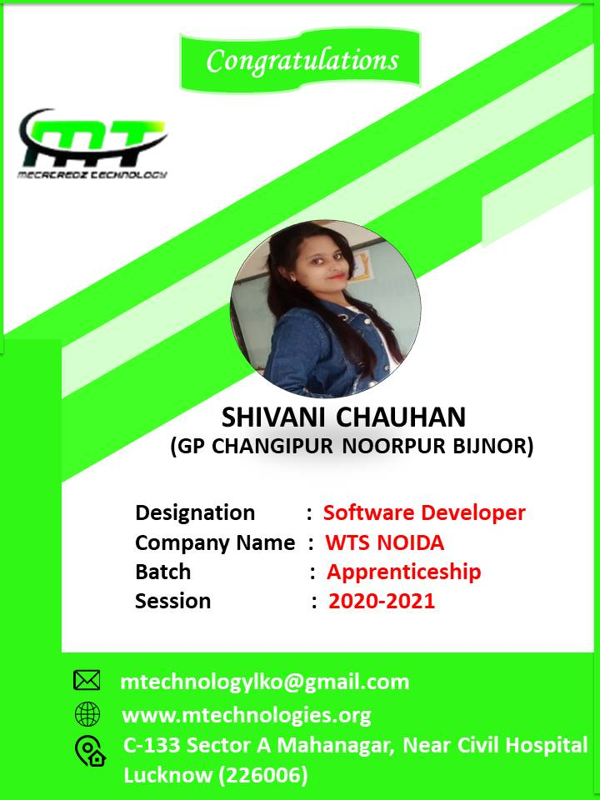

AN ISO 9001:2015 CERTIFIED COMPANY
MECATREDZ TECHNOLOGY PVT LTD LUCKNOW
OUR Session 2020-21 Placement Record

Slide 22
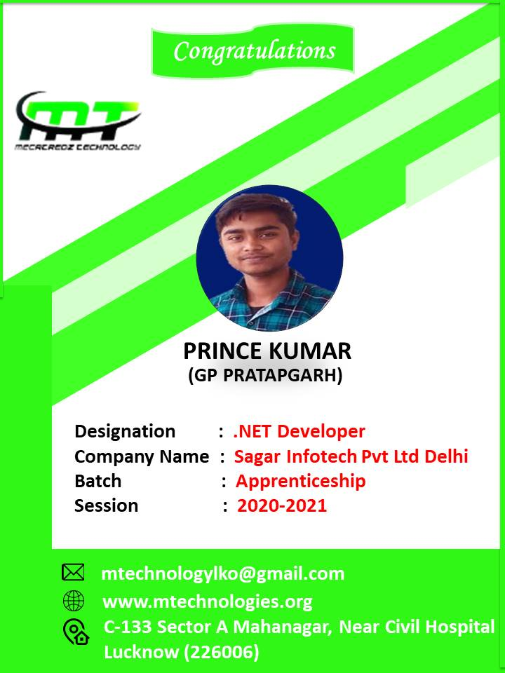
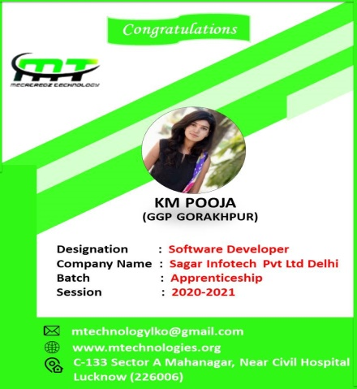
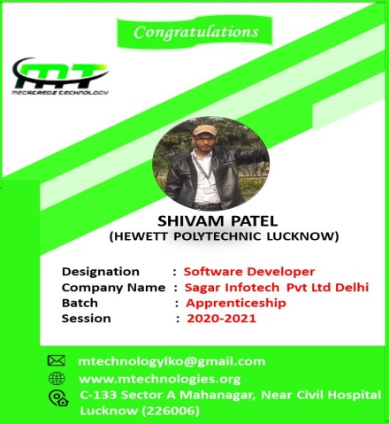
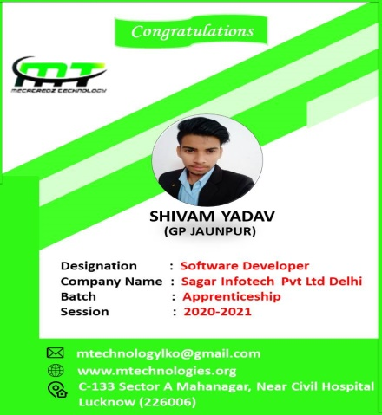
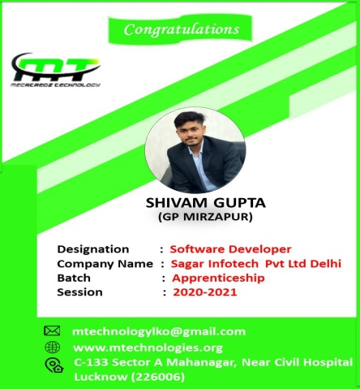






AN ISO 9001:2015 CERTIFIED COMPANY
MECATREDZ TECHNOLOGY PVT LTD LUCKNOW
OUR Session 2020-21 Placement Record

Slide 23











AN ISO 9001:2015 CERTIFIED COMPANY
MECATREDZ TECHNOLOGY PVT LTD LUCKNOW
OUR Session 2020-21 Placement Record

Slide 24






AN ISO 9001:2015 CERTIFIED COMPANY
MECATREDZ TECHNOLOGY PVT LTD LUCKNOW
OUR Session 2020-21 Placement Record

Slide 25



Our Placement Record 2019
DIRECTOR
Easy to change colors, photos and Text.

Slide 26






Add Text
Add Text
Add Text
Add Text

Slide 27
OUR Old College
Government Girls Polytechnic Lucknow
Government Polytrechnic Lucknow
Hewett Polytechnic Lucknow
JLNP Mahmudabad
MMIT Santkabirnagar
MMIT Siddharthanagr
MMIT Shravasti
MMIT Aligarh
MMIT Maharajganj
Government Girls Polytechnic Gorakhpur
Government Girls Polytechnic Amethi
Government Girls Polytechnic Ayodhya
CMS Government Girls Polytechnic Meerut
KM Government Girls Polytechnic Badalpur
Government Girls Polytechnic Bahraich
Government Polytechnic Madhogarh
Government Polytechnic Aurai
Government Polytechnic Pratapgarh
Government Polytechnic Gonda
Government Polytechnic Rampur
Government Polytechnic Kaushambi
TGBG Shravasti
Government Polytechnic Jaunpur
Government Girls Polytechnic Vanaras
Government Girls Polytechnic Meza
GOVT. POLYTECHNIC, MIRZAPUR
Savitribai fulegovt polytechnic saharanpur
MAHATAMA JYOTIBAPHULE GP, KAUSHAMBI
CSJM AmbedkarNagar
Government Polytechnic Unnao
FGIT Raibarelly
BSSITM Lucknow
Azad Institute of Technology Lucknow
BNCT Lucknow
GCRG Lucknow
SR Lucknow
BBD University Lucknow
RR Institute Of Technology
Integral University Lucknow

Slide 28
THANK YOU

